Slide 1



Differentials
Differentials are a powerful mathematical tool
They require, however, precise introduction
exact
In particular we have to distinguish between
differentials
inexact
Remember some important mathematical background
Multi-Dimensional Spaces
Point (in D-dimensional space)
Line: parametric representation
D functions
depending on a single
parameter

Slide 2

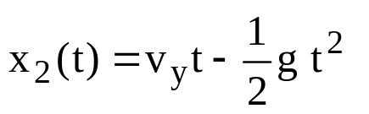

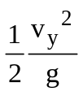




for
Example in D=2 from classical mechanics
where t₀=0 and t_{f}=2v_{y}/g
x₂
0
x₁

Slide 3


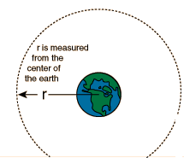
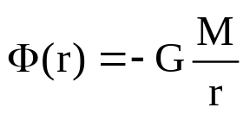
Scalar field: a single function of D coordinates
For example: the electrostatic potential of a charge or the gravitational potential
of the mass M (earth for instance)
r

Slide 4
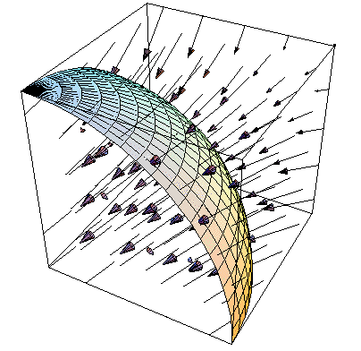
Vector field: specified by the D components of a vector.
Each component is a function of D coordinates
Graphical example in D=3
Well-known vector fields in D=3
Force F(r) in a gravitational field
Electric field: E(r)
3 component entity
Magnetic field: B(r)
Each point in space
z
y
x

Slide 5
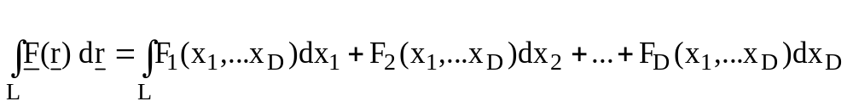


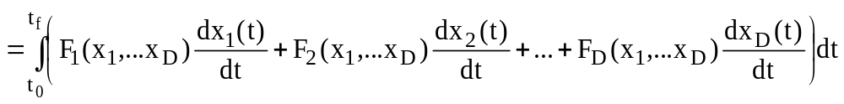
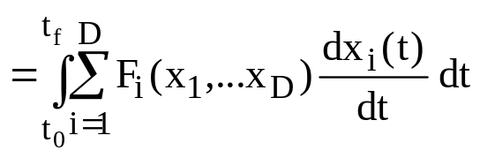
Line integral:
scalar product
If the line has the parameter representation:
i=1,2,…,D
for
The line integral can be evaluated like an ordinary 1-dimensional definite Integral

Slide 6


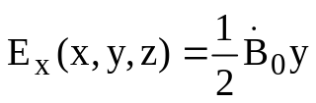
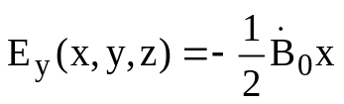

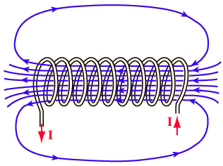



Let’s explore an example:
Consider the electric field created by a changing magnetic field
where
y
x
z
t
y
y
y
Line of integration
R
x
x
f
0
x

Slide 7
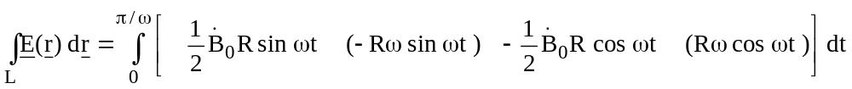




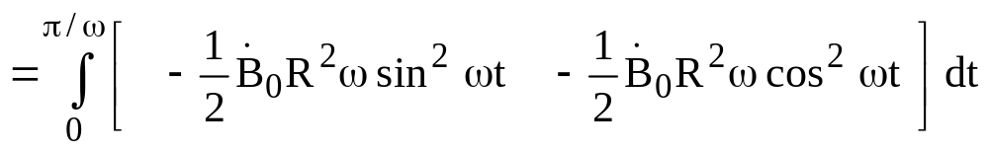
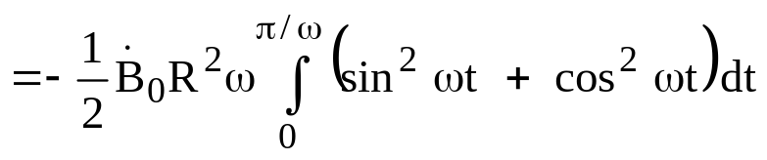
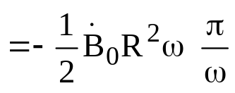
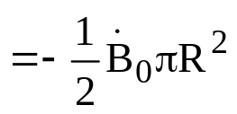
Parameter representation of the line:
Counter clockwise walk along the semicircle of radius R
y
x
1
Note: Result is independent
of the parameterization

Slide 8
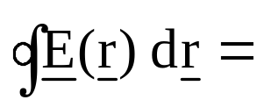
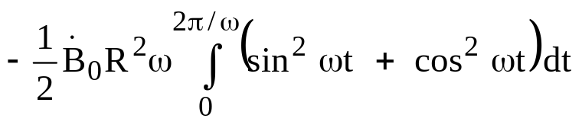
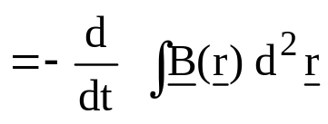

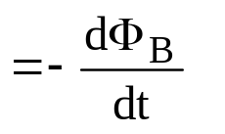
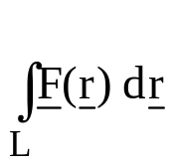
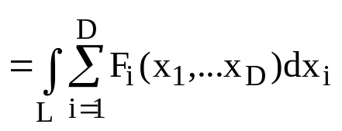
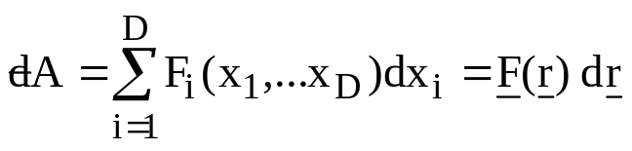

y
Line of integration
Let’s also calculate the integral around the full circle:
Parameter representation of the line:
R
x
Faraday’s law of electrodynamics
Have a closer look to
Differential form
or

Slide 9
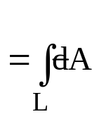


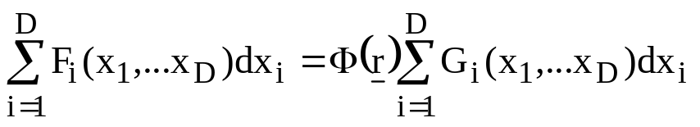




Meaning of an equation that relates one differential form to another
Equation valid for all lines
Must be true for all sets of coordinate differentials
Example:
Particular set of differentials
Relationships valid for vector fields are
also valid for differentials

Slide 10
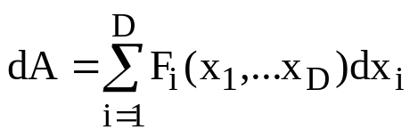
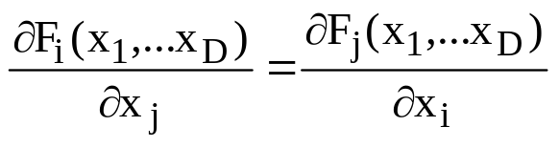


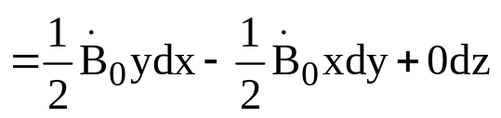

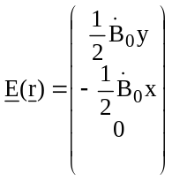
Exact and Inexact Differentials
A differential form
is an exact differential
if for all i and j it is true that
.
An equivalent condition reads:
also written as
Let’s do these Exactness tests in the case of our example
Is the differential form
exact
y
x
z
t

Slide 11
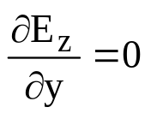
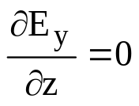
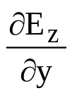
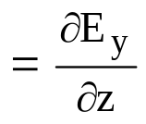
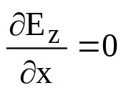
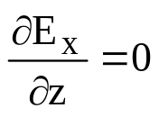
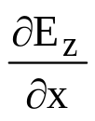
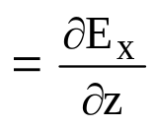
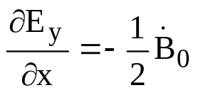
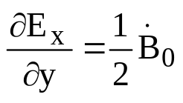
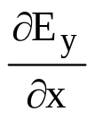
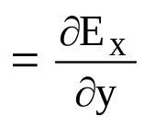

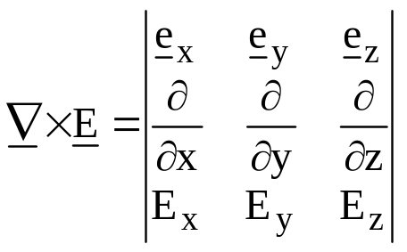
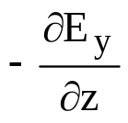
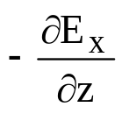
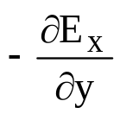




Check of the cross-derivatives
but
Not exact
Alternatively we can also show:
=
-
+
=
= 0

Slide 12







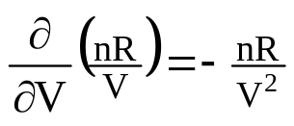
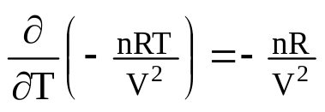

Example from thermodynamics
Exactness of
1
Transfer of notation:
T , V are the coordinates of the space
Functions corresponding to the vector components:
2
Check of the cross-derivatives
=
exact

Slide 13
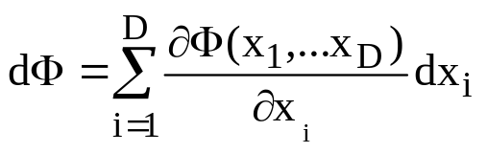

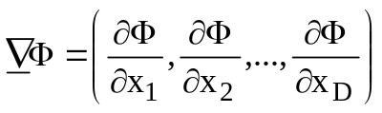
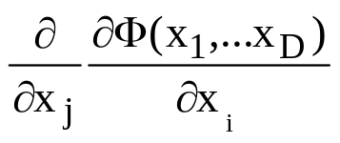






Differential of a function
Scalar field: a single function of D coordinates
or in compact notation
where
Differentials of functions are exact
Proof:
Or alternatively:
x₂
x₁
Line integral of a differential of a function
Independent of the path
between
and

Slide 14



We are familiar with this property from varies branches of physics:
Conservative forces:
Remember: A force which is given by the negative gradient
of a scalar potential is known to be conservative
Example:
Gravitational force derived from
Pot. energy
depends
on Δh, not how
to get there.
Δh

Slide 15


Exact differential theorem
The following 4 statements imply each other
1
dA is the differential of a function
2
dA is exact
3
for all closed contours
4
Independent of the line connecting
and
x₂
x₁

Slide 16





How to find the function underlying an exact differential
Consider:
Since dA exact
Aim:
Find A(x,y) by integration
constant
Comparison
Unknown function depending on y only
A(x,y)
Apart from
one const.
Unknown function depending on x only
constant

Slide 17











Example:
where a,b and c are constants
First we check exactness
Comparison
Check:

Slide 18









Inexact Differentials of Thermodynamics
We know:
Equilibrium processes can be represented by lines in state space
Consider infinitesimal short sub-process
Quantities of infinitesimal short sub-processes
Values of W,Q and
are
With first law
for all lines L
Since U is a state function we can express
U=U(T,V)
dU differential form of a function
dU exact
However:
inexact

Slide 19













How can we see that
inexact
Compare with the general differential form
for coordinates P and V
and
=
inexact
Example:
Line dependence of W and line independence of U
P₀
Work:
isothermal
P_{f}
V₀
V_{f}

Slide 20








Coordinates on common isotherm
=
Internal energy:
1
Isothermal process from
P
Ideal gas
U=U(T)
V
P₀
1
2
2
Across constant volume and constant pressure path
P_{f}
V₀
V_{f}

Slide 21















T₀= T_{f}
-R
+R
How can we see that
is inexact
Consider U=U(P,V)
where P and V are the coordinates
with
Since
inexact
Alternatively inspection of
inexact
exact
inexact

Slide 22






Coordinate transformations
Example:
Changing coordinates of state space from (P,V)
(T,P)
V=V(T,P)
If U=U(T,P)
With
+

Slide 23





Let’s collect terms of common differentials
Remember: Enthalpy
H=U+PV
with
Similar for changing coordinates of state space from (P,V)
(T,V)

Slide 24










Heat capacities expressed in terms of differentials
From
P=const.
and
V=const.
Note:
and
are alternate notation for the components
and
(of the above vector fields which correspond to the differential forms)
Do not confuse with partial derivatives, since there is no function Q(T,P)
whose differential is
.
is inexact

